Slide 1

Electronic prescribing Web Application
Osama Haddad 2019980022
Supervisor: Dr. Mahmoud masadeh

Slide 2
Road Map
01 Introduction
02 Design
03 Implementation
04 Future works
05 Conclusion

Slide 3
01 Introduction
What is Electronic Prescribing?
Why Electronic Prescribing?

Slide 4
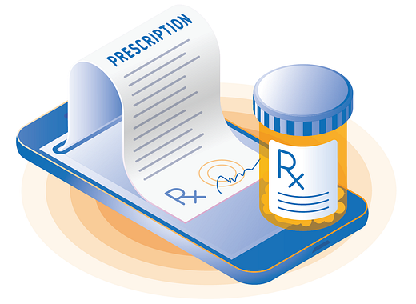
What is E-prescribing?
E-prescribing is a website system enables a prescriber(physician) to electronically send an accurate, error-free and understandable prescription directly to a pharmacy from the point-of-care and is an important element in improving the quality of patient care.

Slide 5

Why E-Prescribing?
- Reduce medical errors, decrease pharmacy costs, improve both prescriber and refill requests pharmacy efficiency.
- Eliminate handwriting interpretation errors, reduce phone calls between pharmacists and physicians, reduce data entry, and expedite prescription.

Slide 6
02 Design

Slide 7





Design
I use:
HTML , CSS , TypeScript to program back-end.
NodeJS and Angular to program front-end.
MySQL Workbench to store all data for website users and information’s.

Slide 8
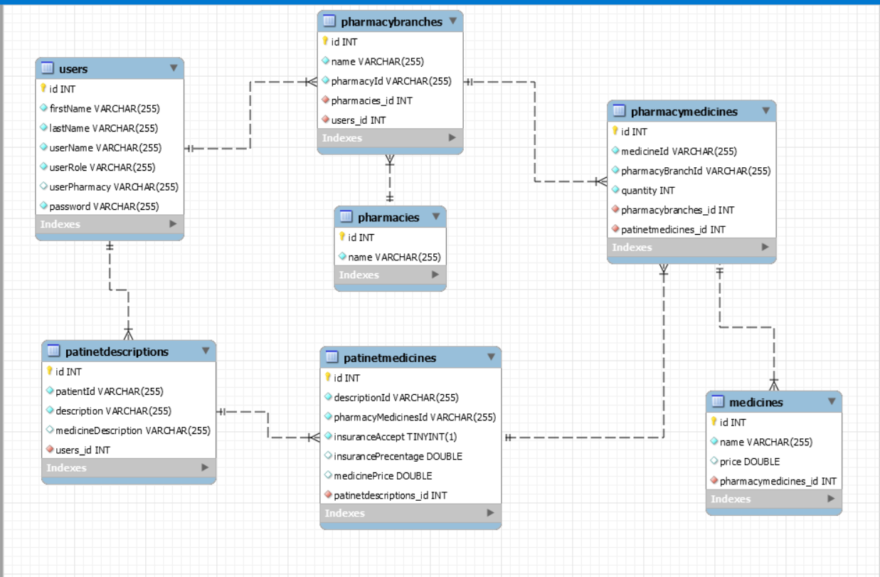
Design
The illustration of the design will be explained throughout the database, which contain tables.

Slide 9
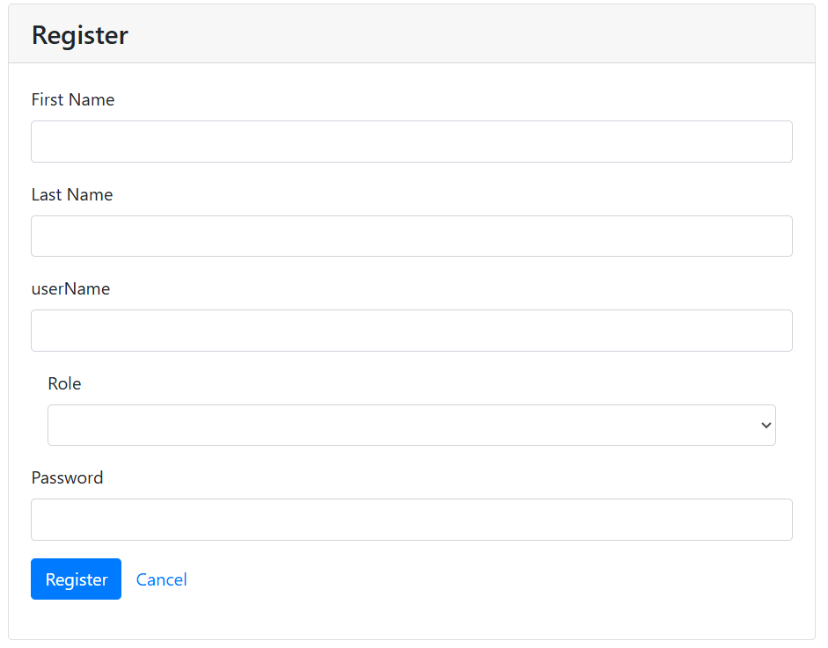
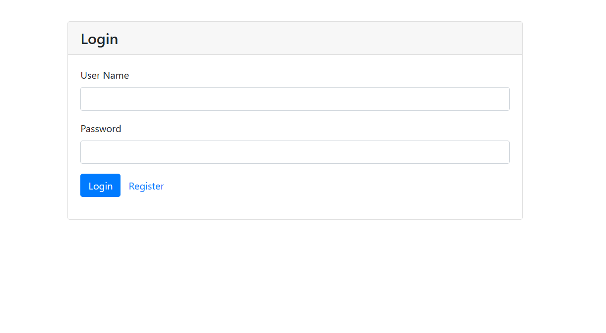
Design
This is the login interface page to allow the users to login to the website, and if it’s the first time to visit the website the user choose register bottom to registration on the system.

Slide 10
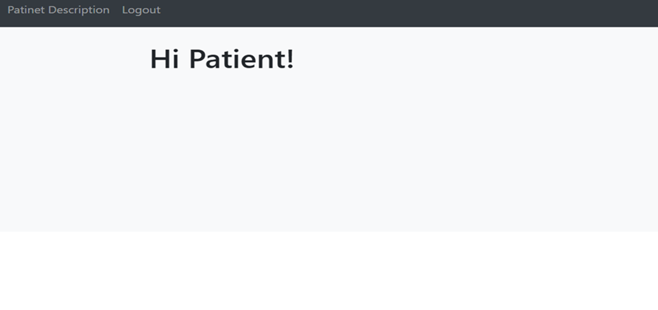
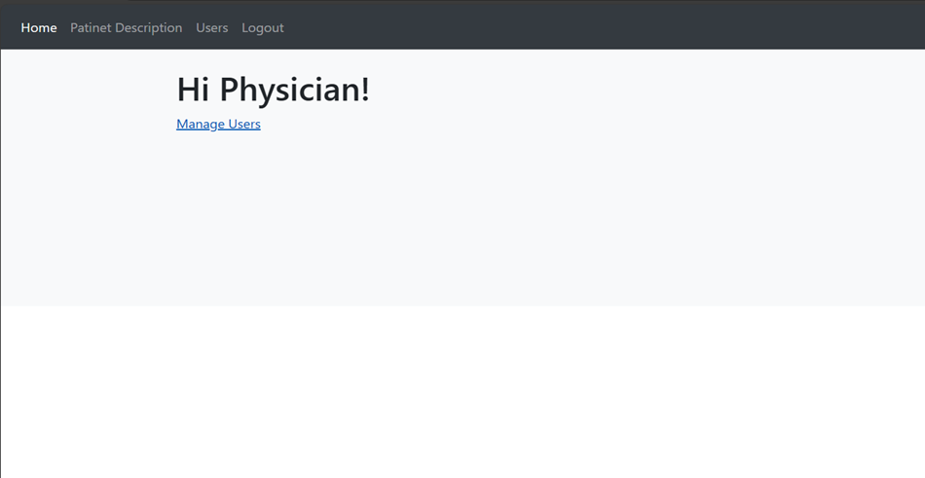
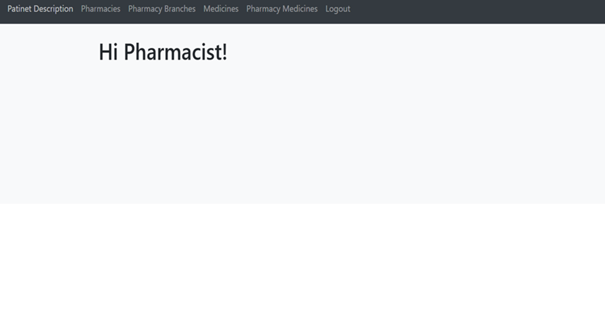
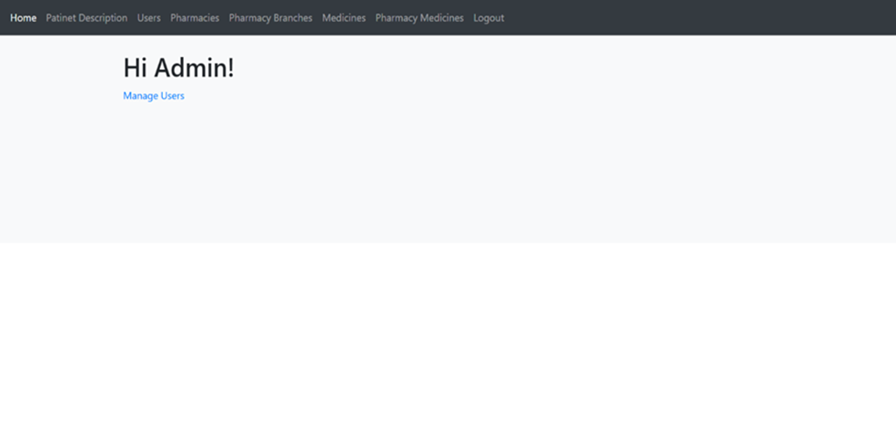
Design
This is the four main pages on the website:
1- Page of patient
2- Page of pharmacist
3- Page of physician
4- Page of Admin

Slide 11
03 Implementation

Slide 12
Implementation
Authentication
login

Slide 13
Implementation
Services
For Admin ( as show in the figures, slides (14-19)) :
Login , Logout.
Add , Edit , Delete patient description.
Manage Users ( Add , Edit , Delete).
Add , Edit , Delete pharmacies.
Add , Edit , Delete pharmacies branches .
Add , Edit , Delete medicines from Pharmacies .
Add , Edit , Delete Pharmacy medicines from Pharmacies .

Slide 14
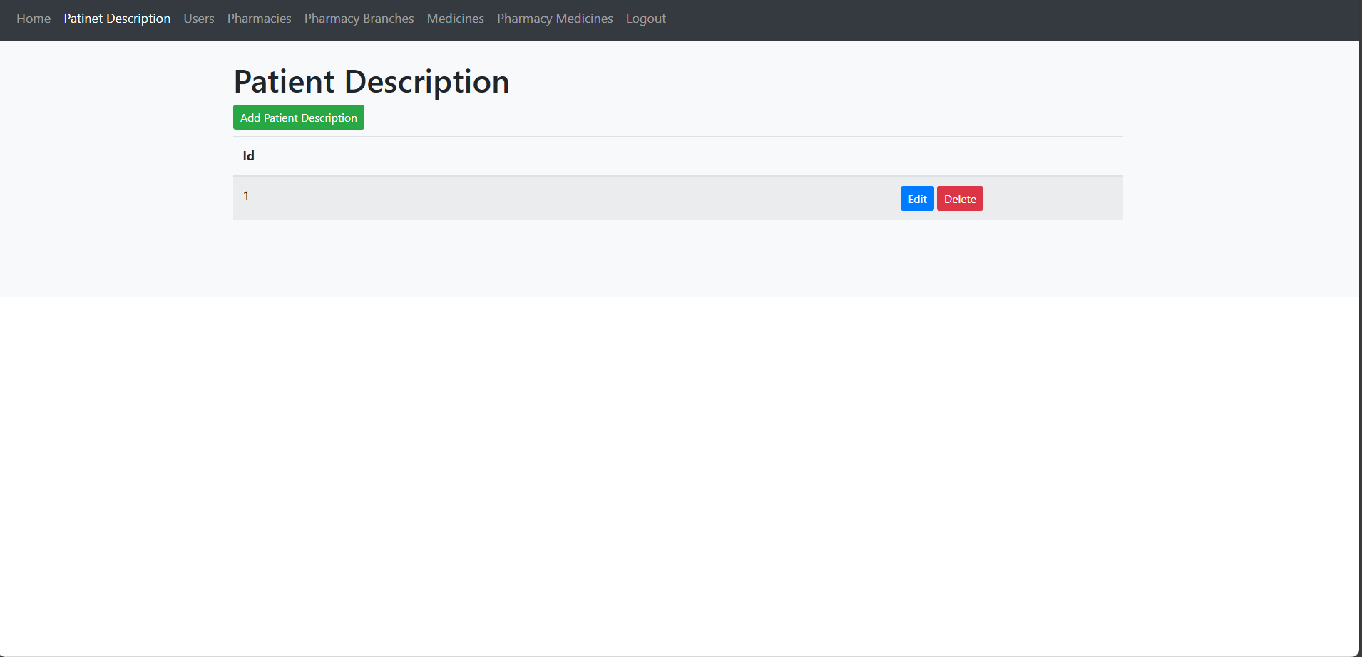
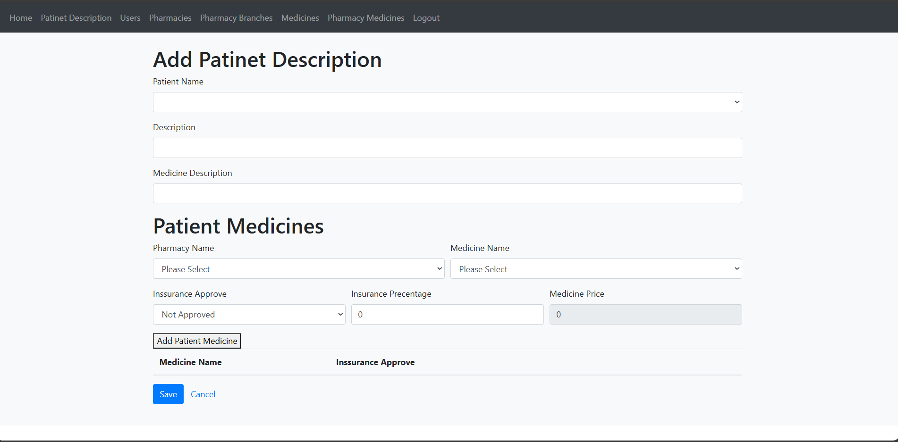
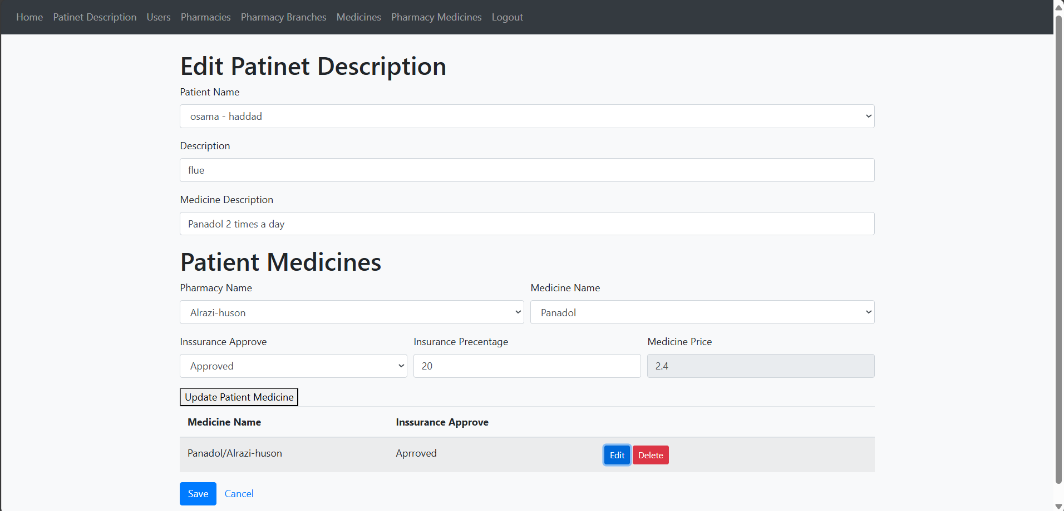
Implementation

Slide 15
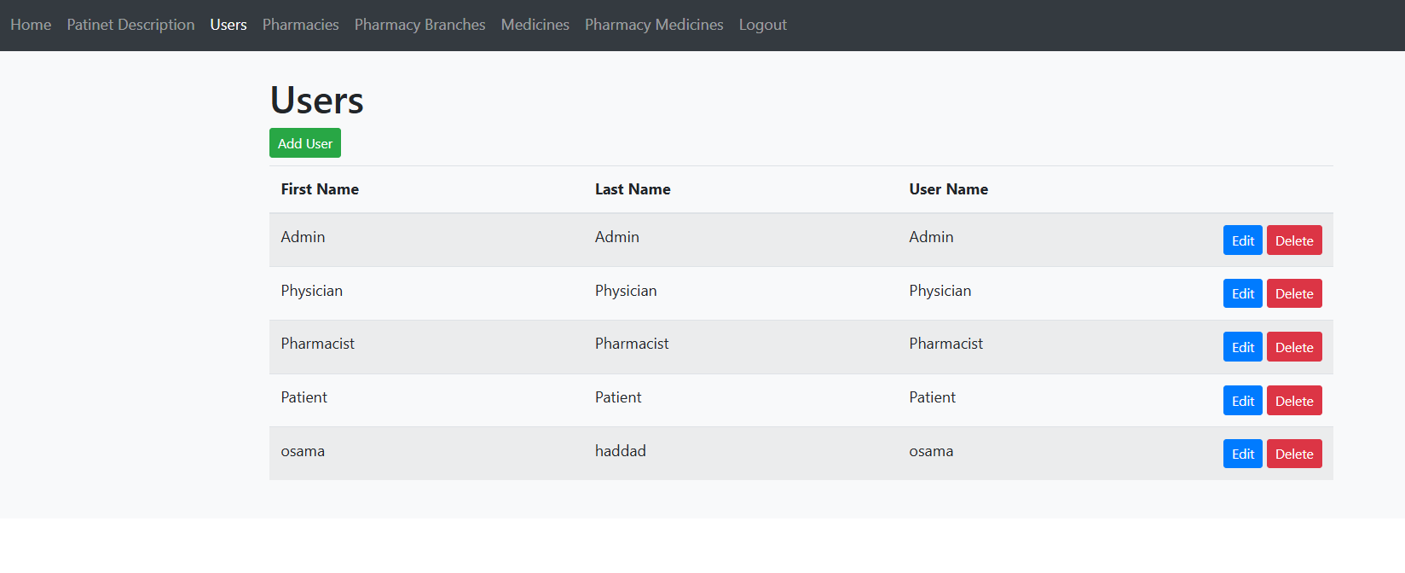
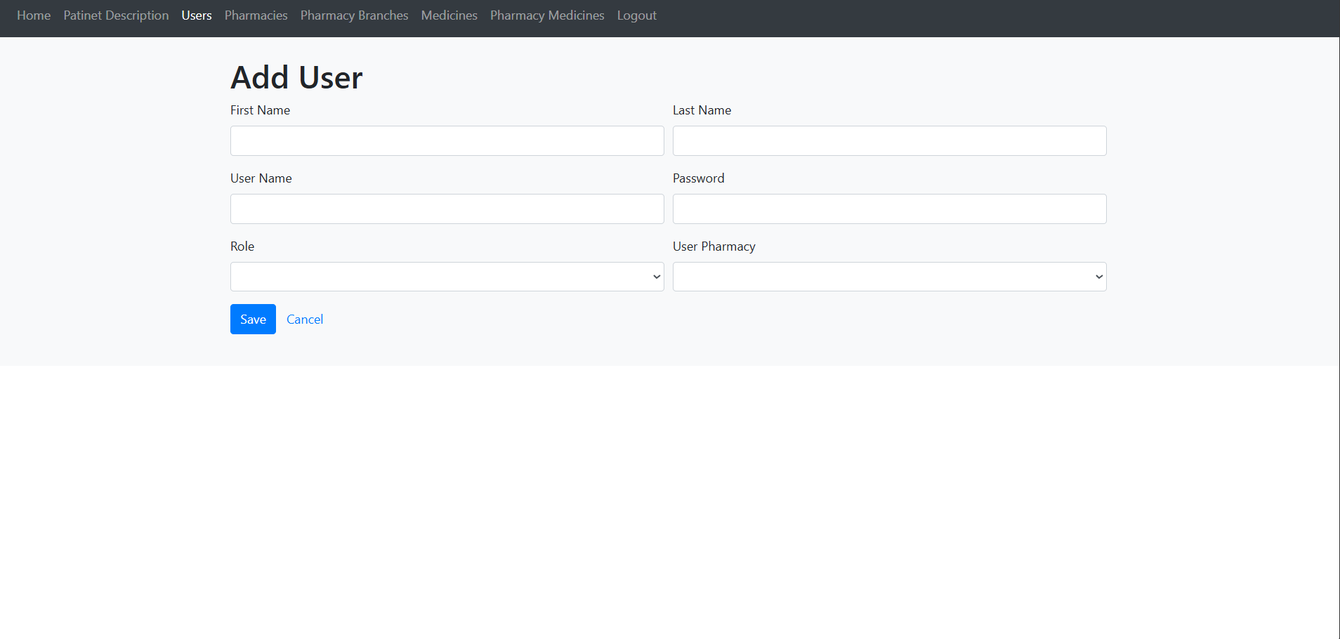
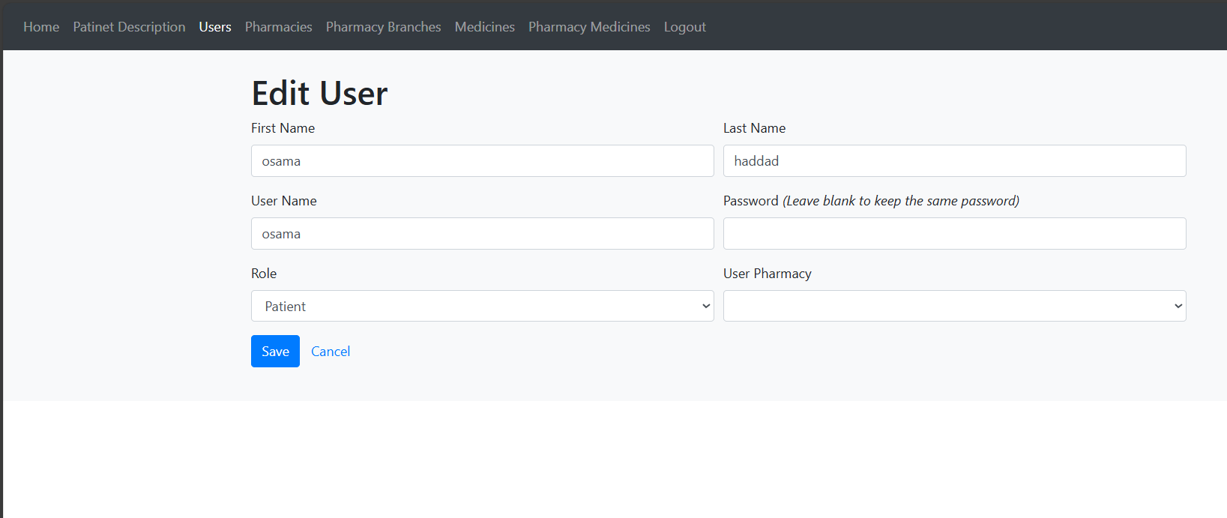
Implementation

Slide 16
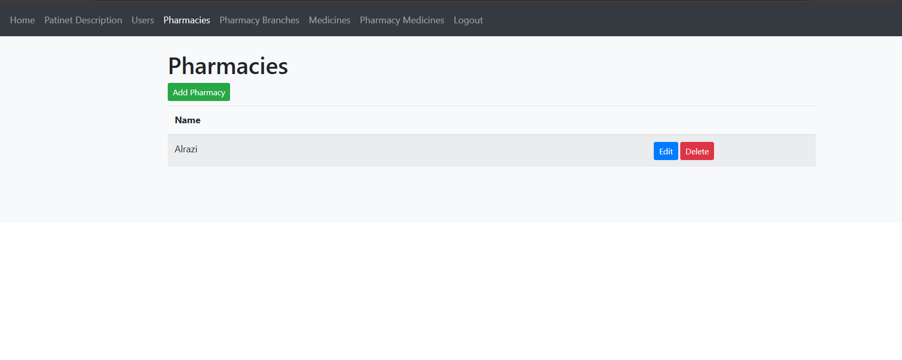
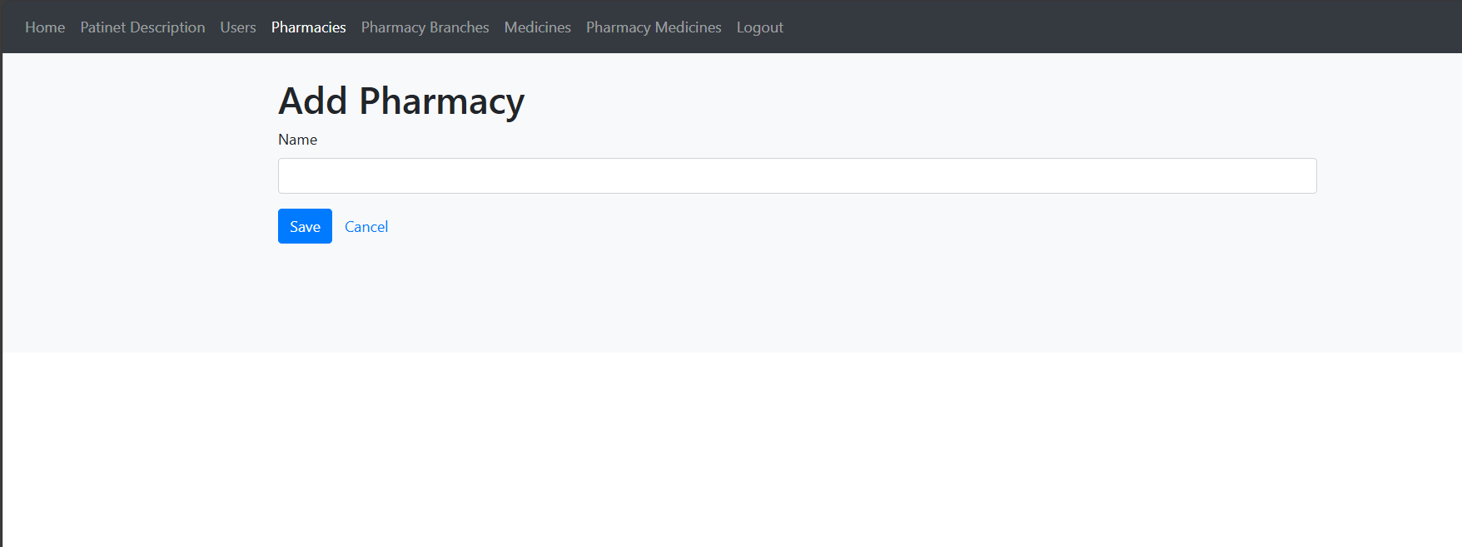
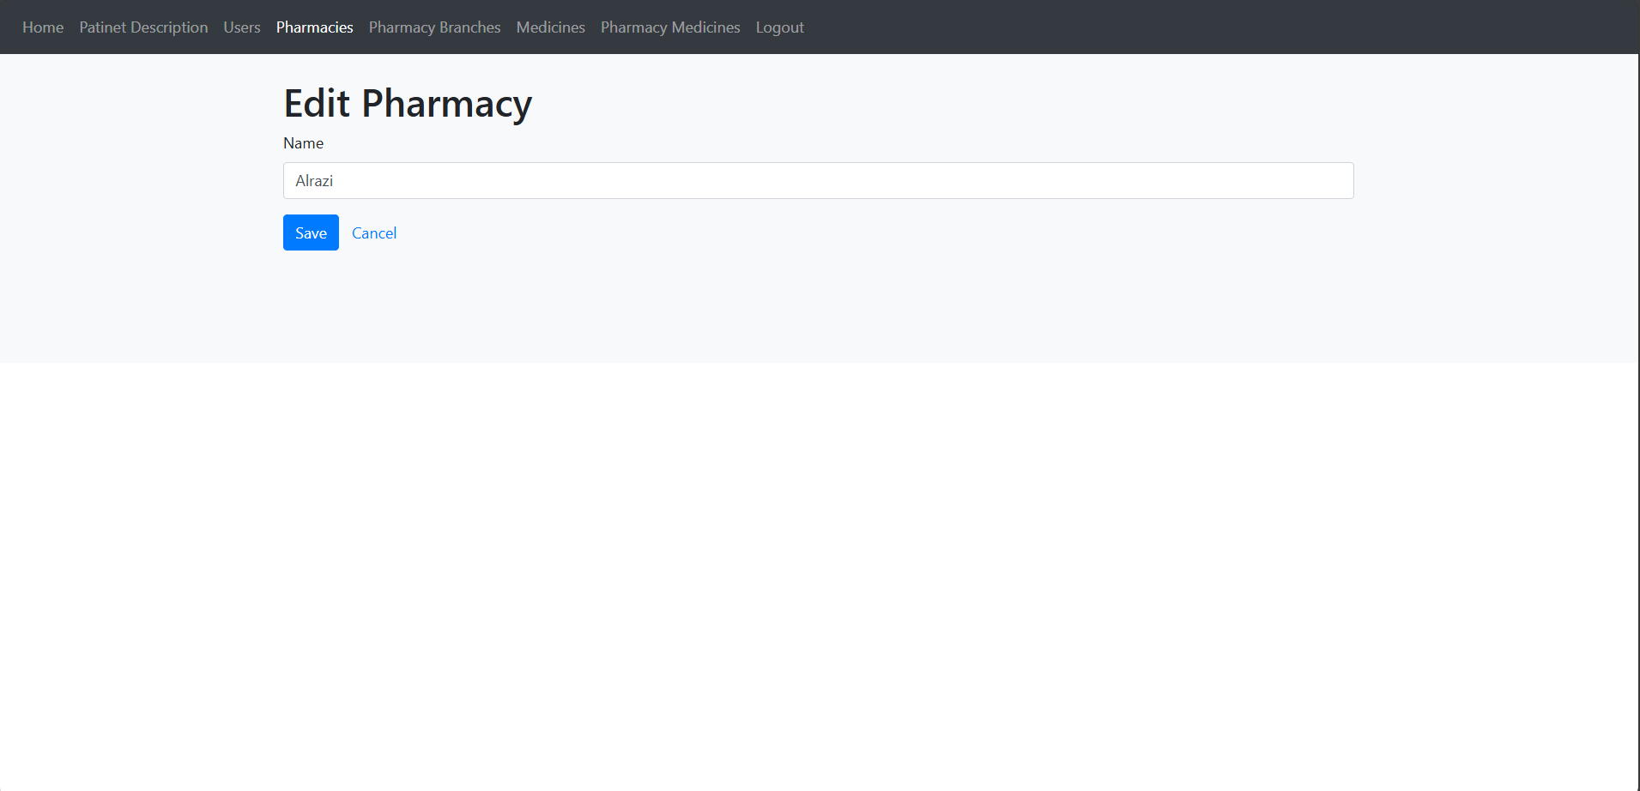
Implementation

Slide 17
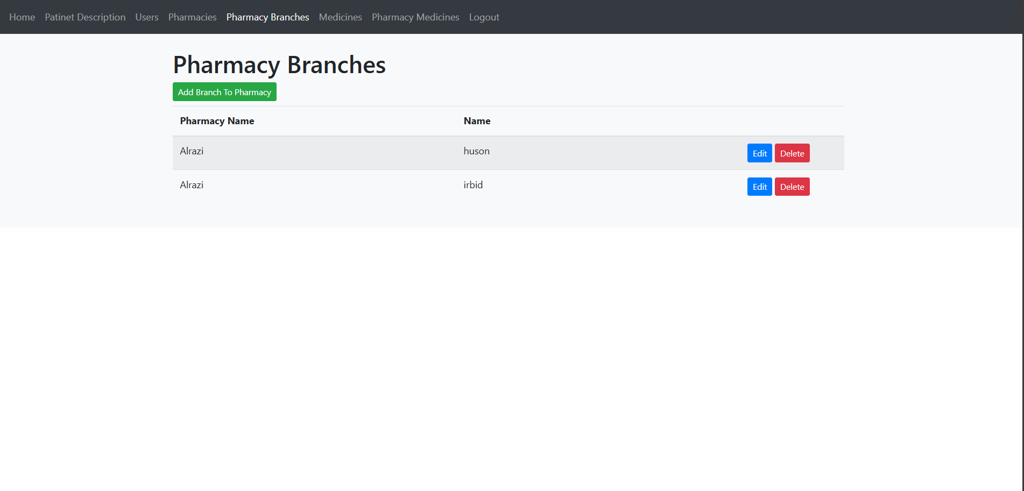
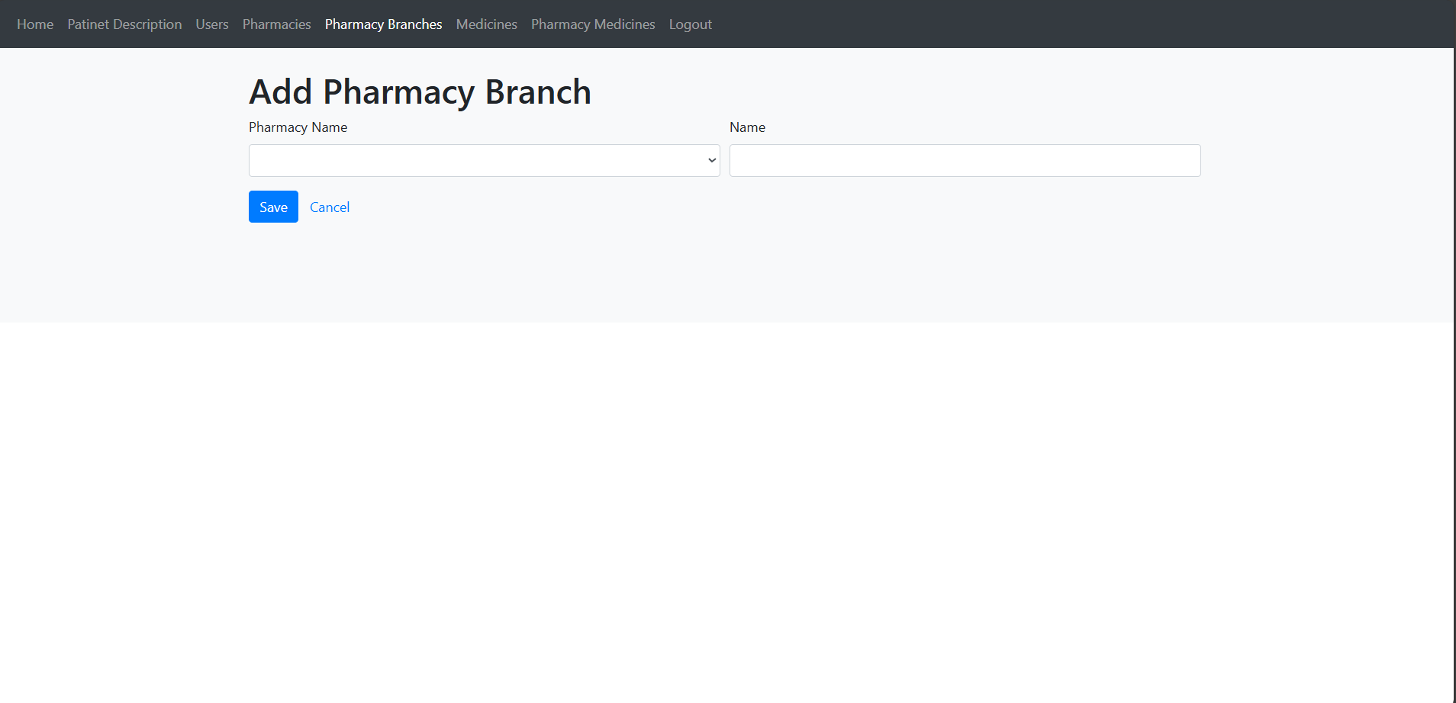
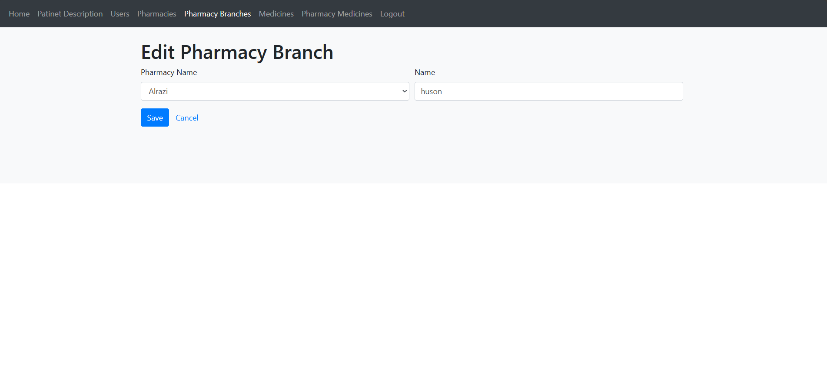
Implementation

Slide 18
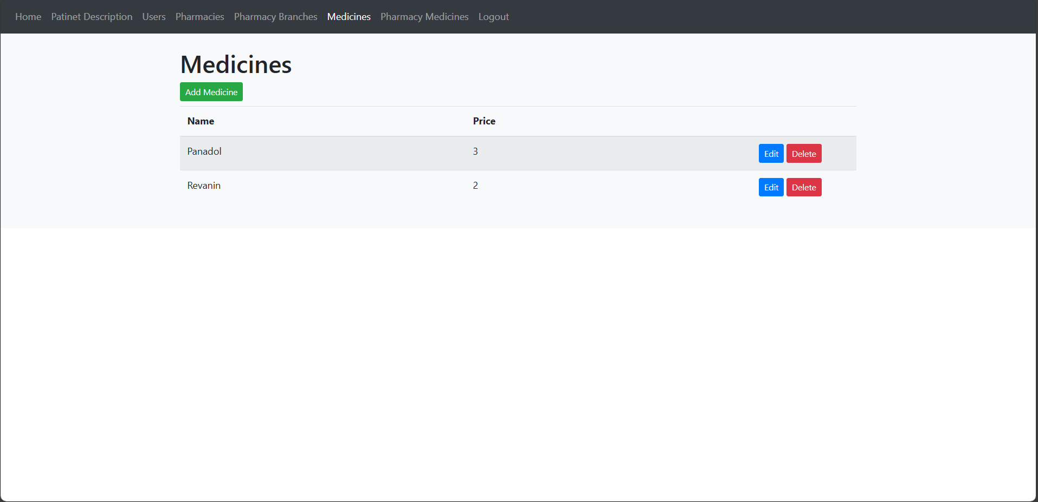
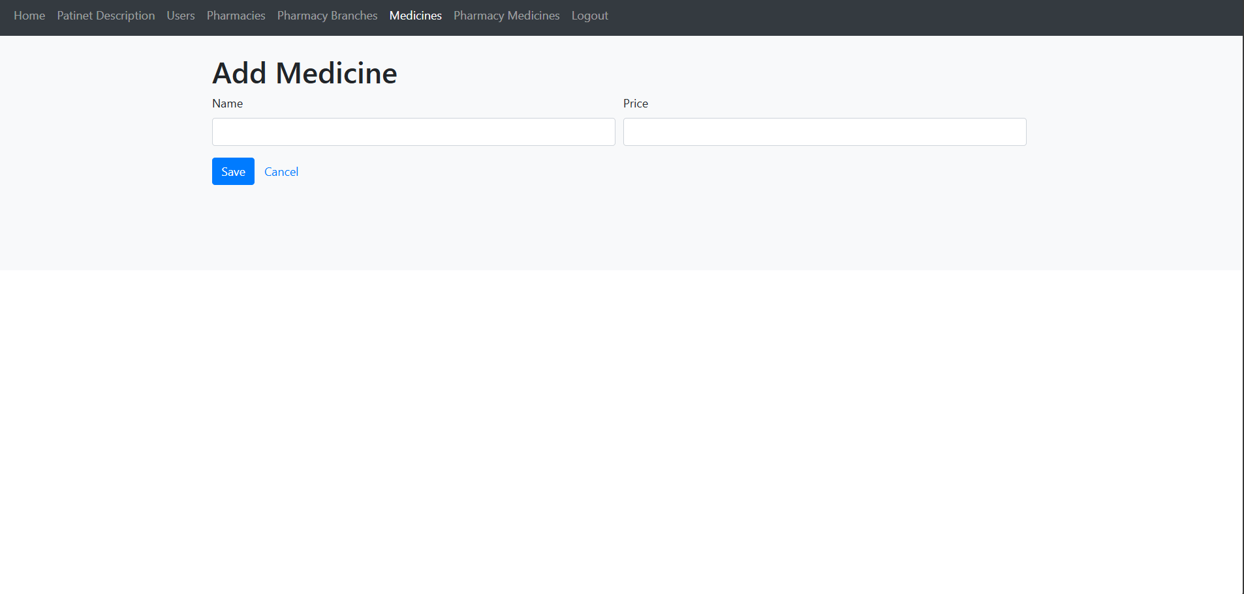
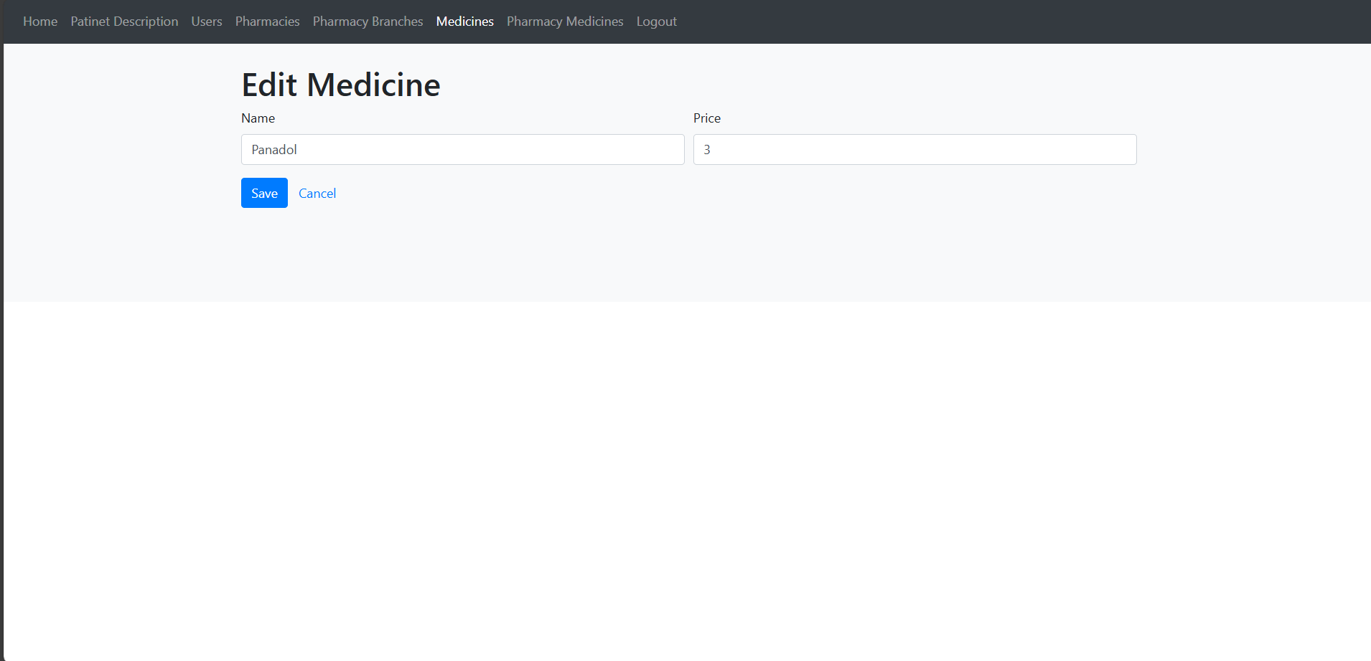
Implementation

Slide 19
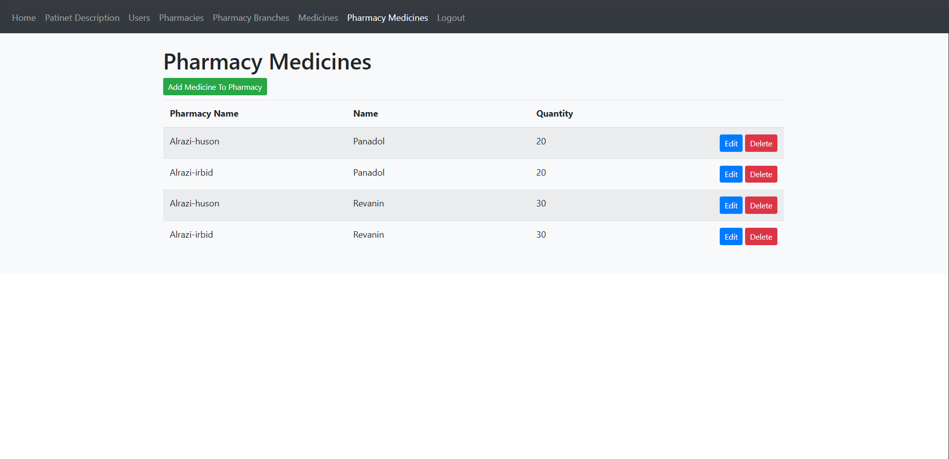
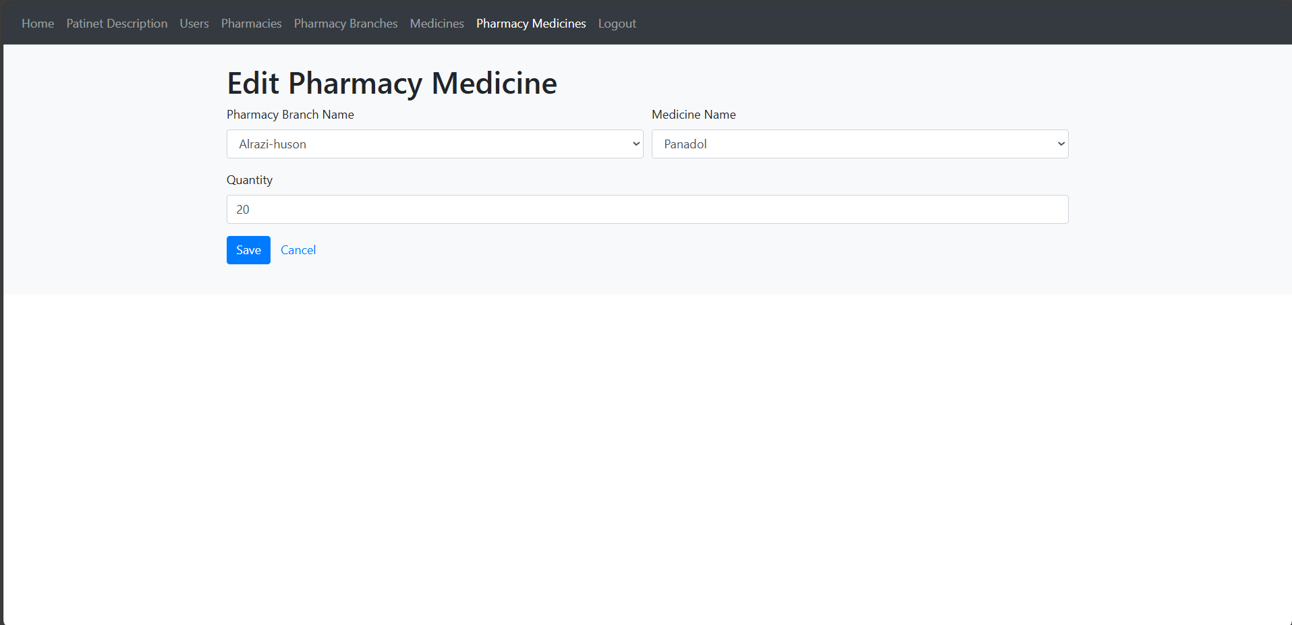
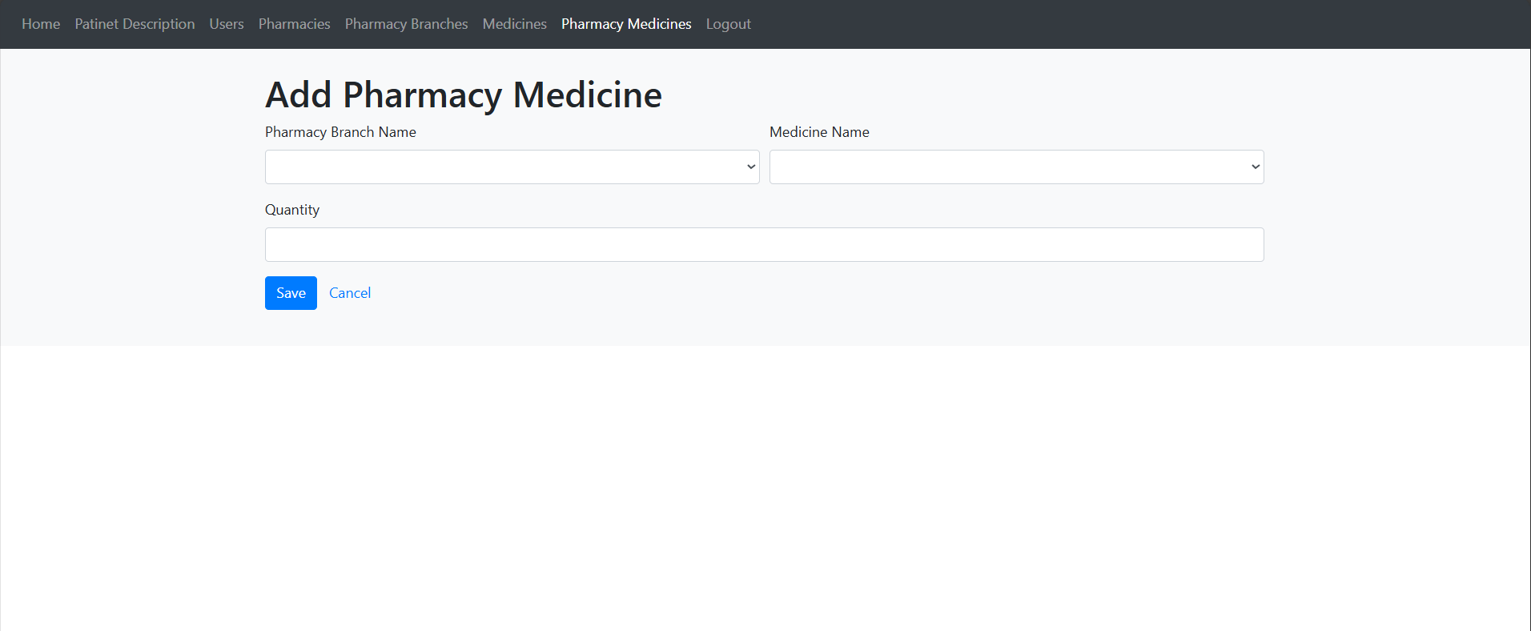
Implementation

Slide 20


Implementation
Services
For Physician ( as show in the figures, slides (21-22)) :
Login , Logout.
Add , Edit , Delete patient description.
Add users.

Slide 21
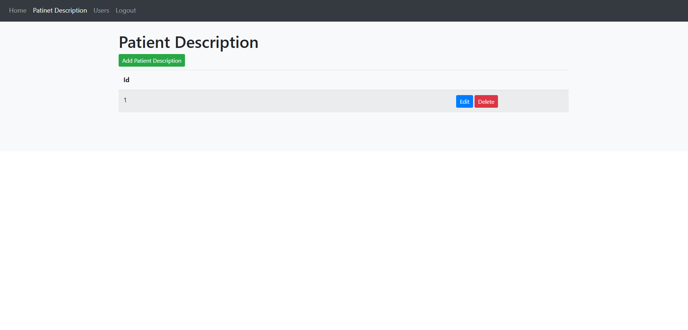
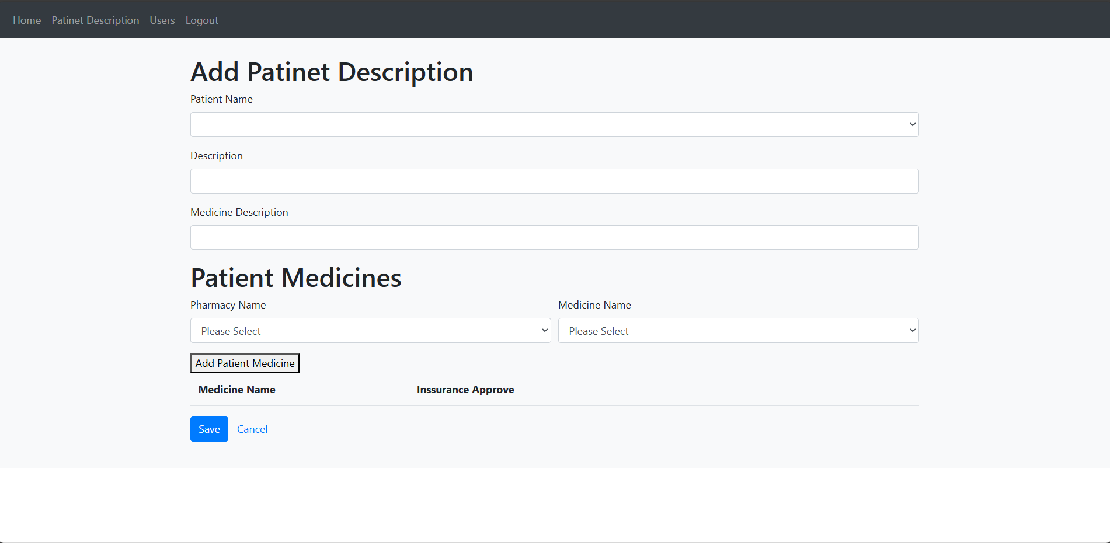
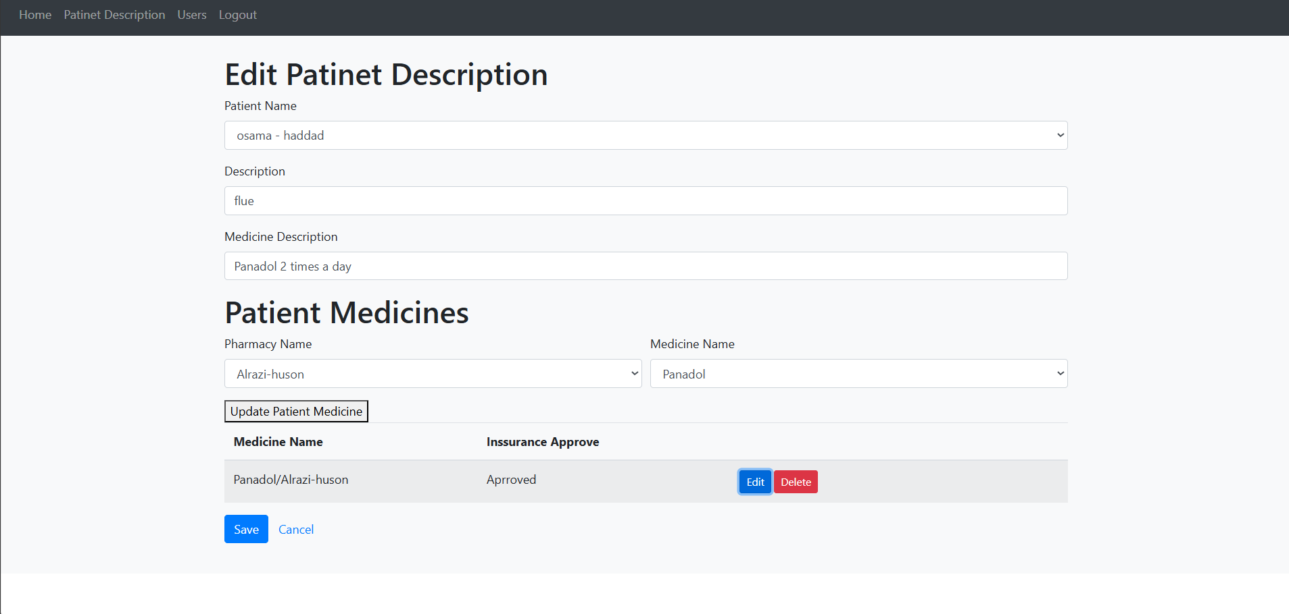
Implementation

Slide 22
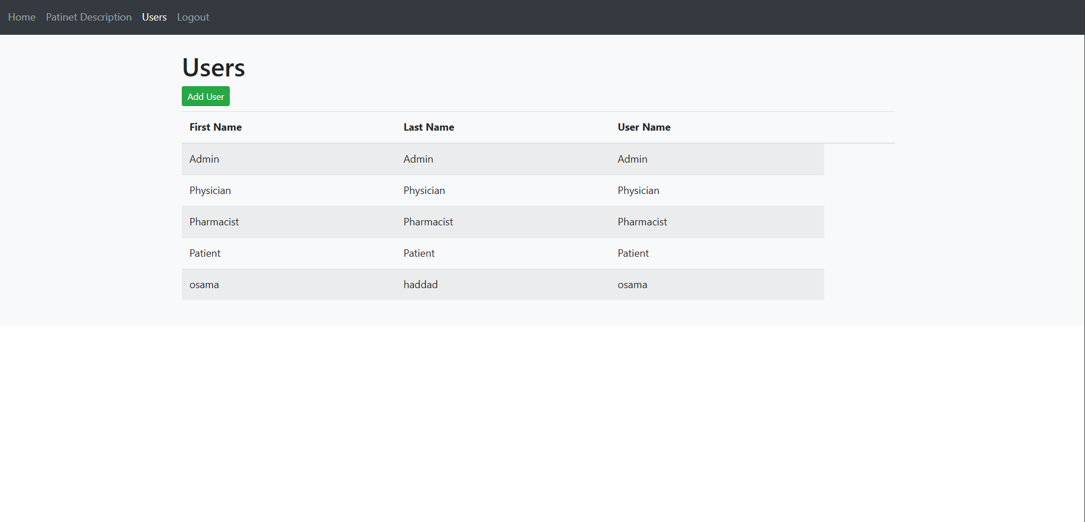
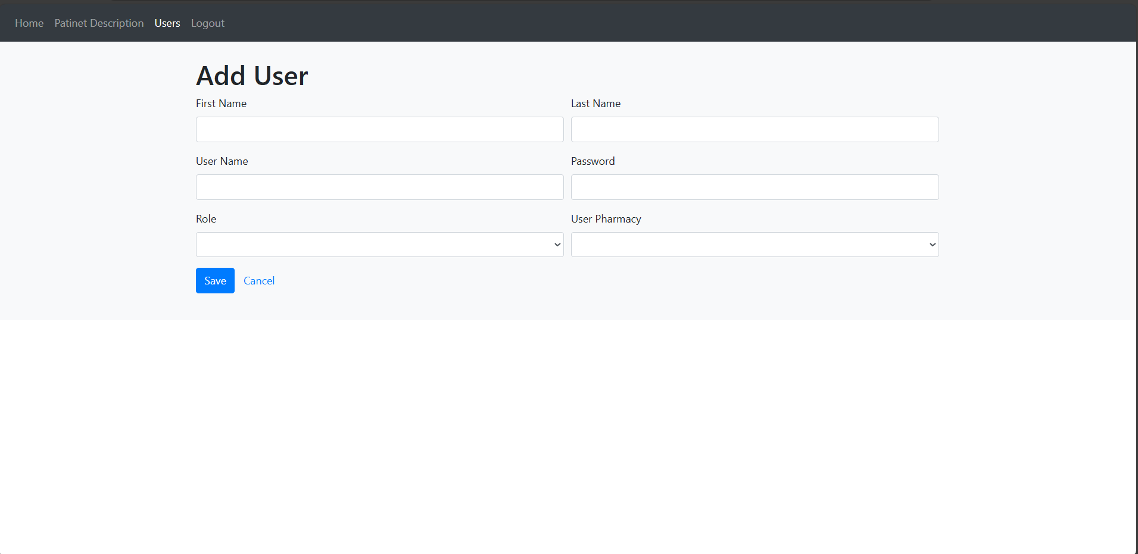
Implementation

Slide 23
Implementation
Services
For Pharmacist ( as show in the figures, slides (24-28)) :
Login , Logout.
Edit patient description.
Add , Edit , Delete pharmacies.
Add , Edit , Delete pharmacies branches .
Add , Edit , Delete medicines from Pharmacies .
Add , Edit , Delete Pharmacy medicines from Pharmacies .

Slide 24
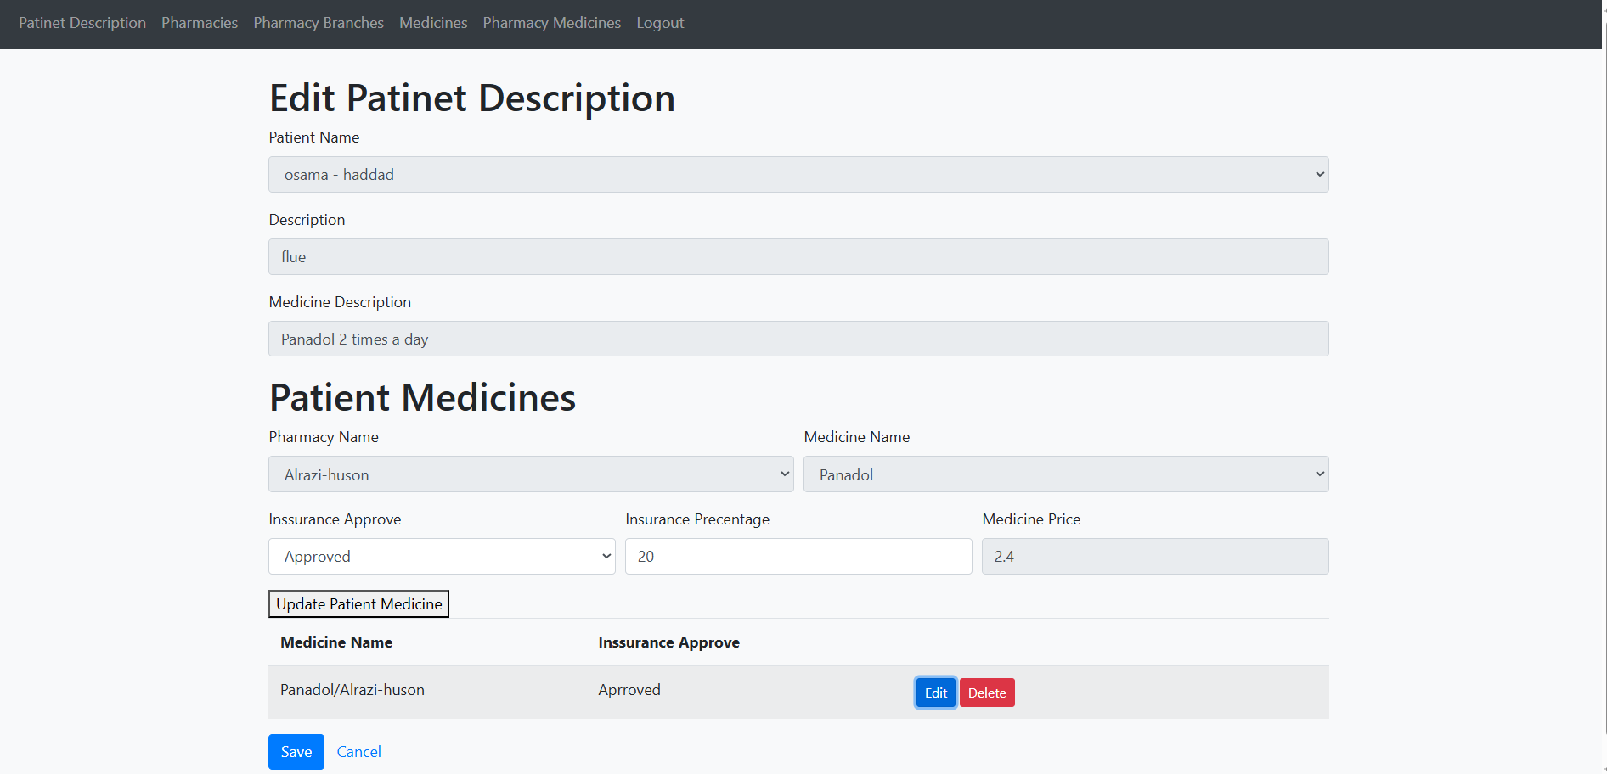
Implementation

Slide 25
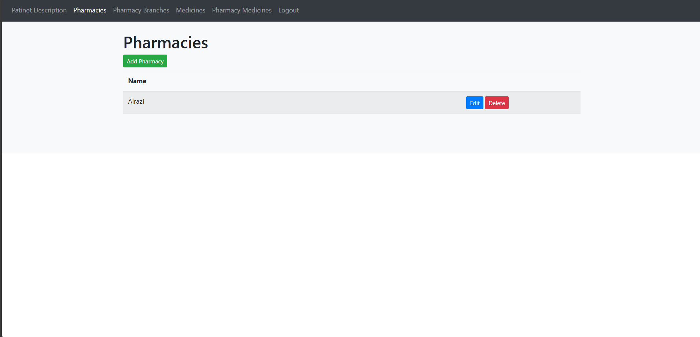
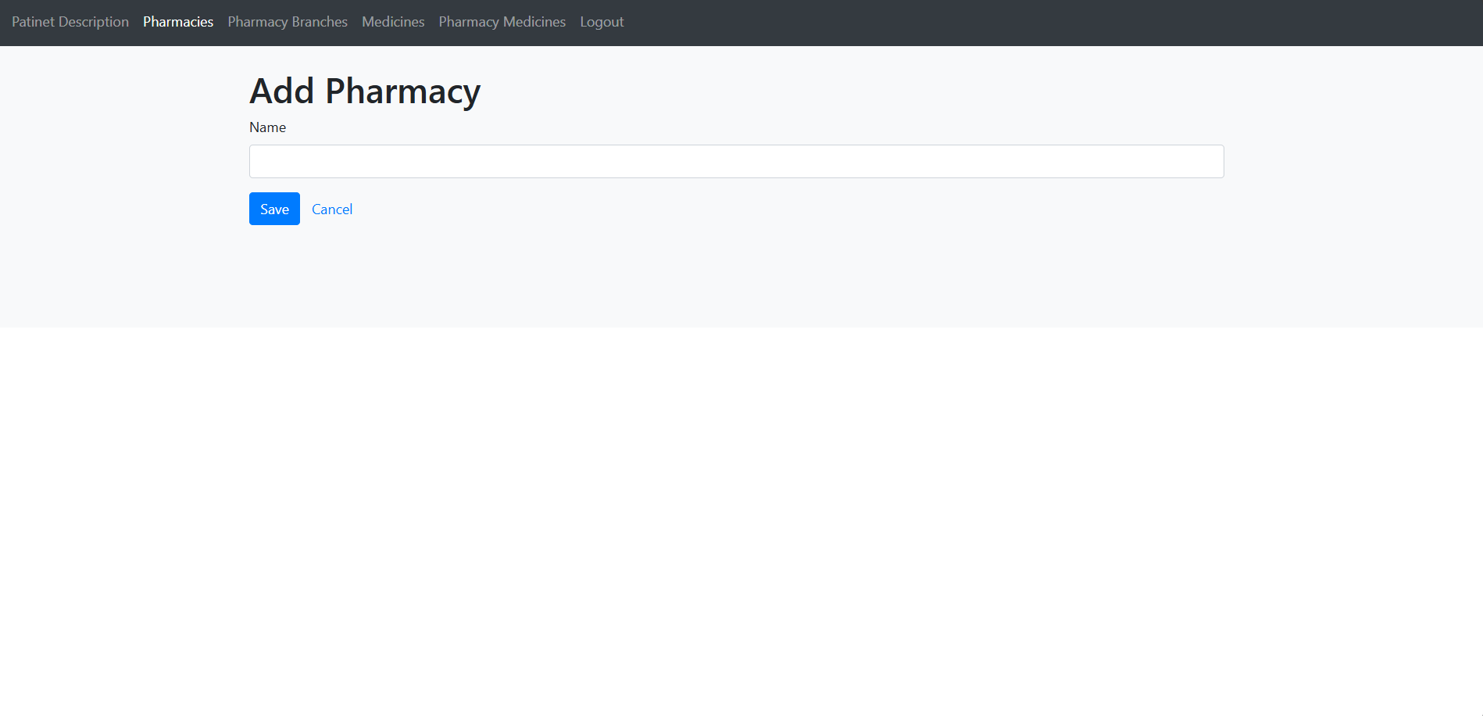

Implementation

Slide 26
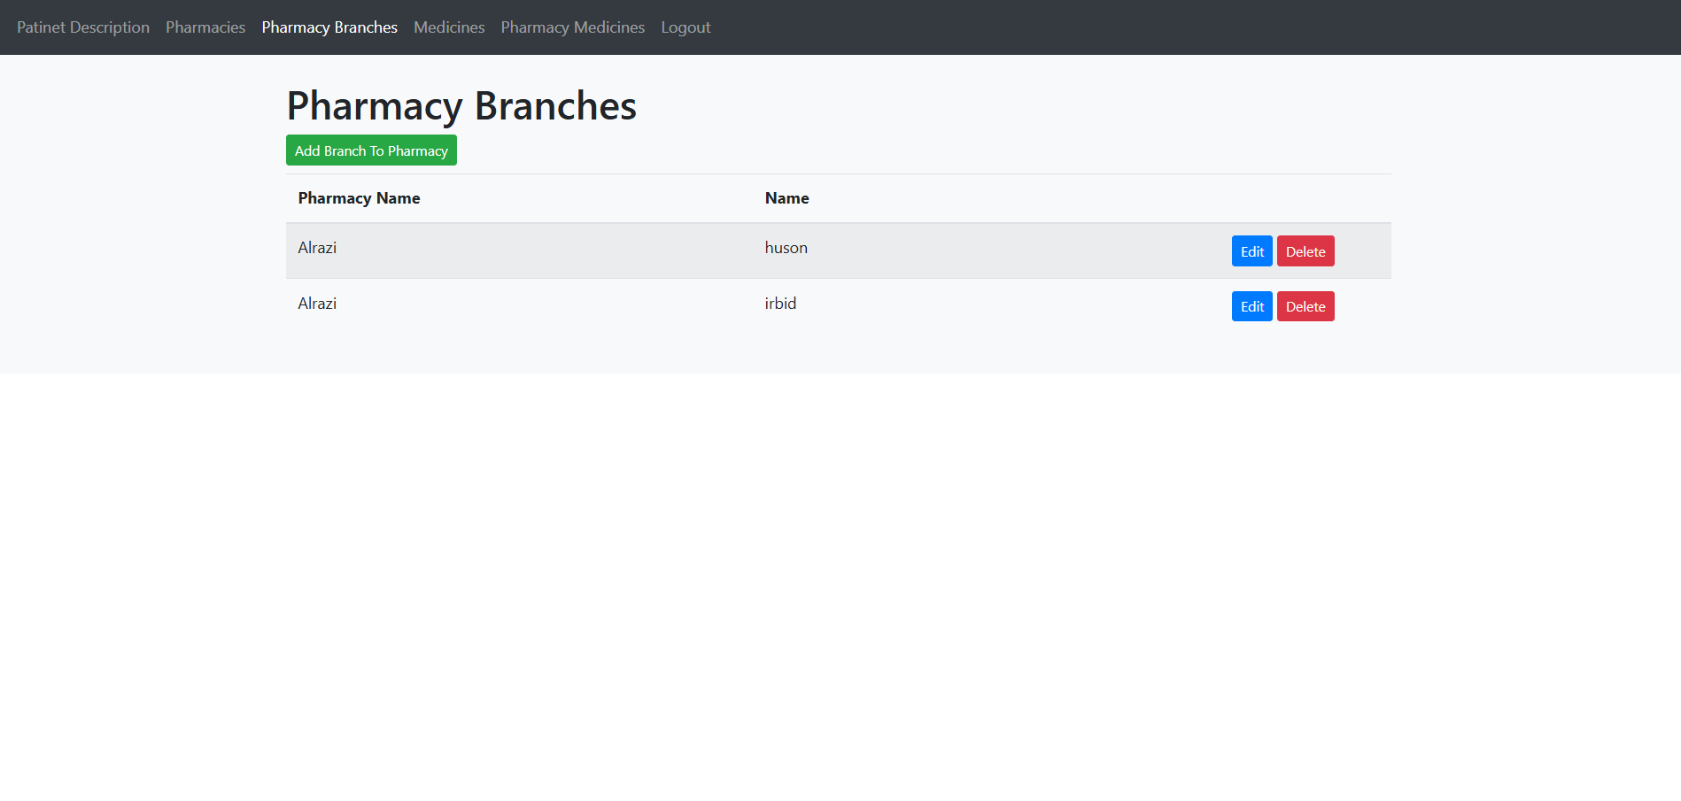
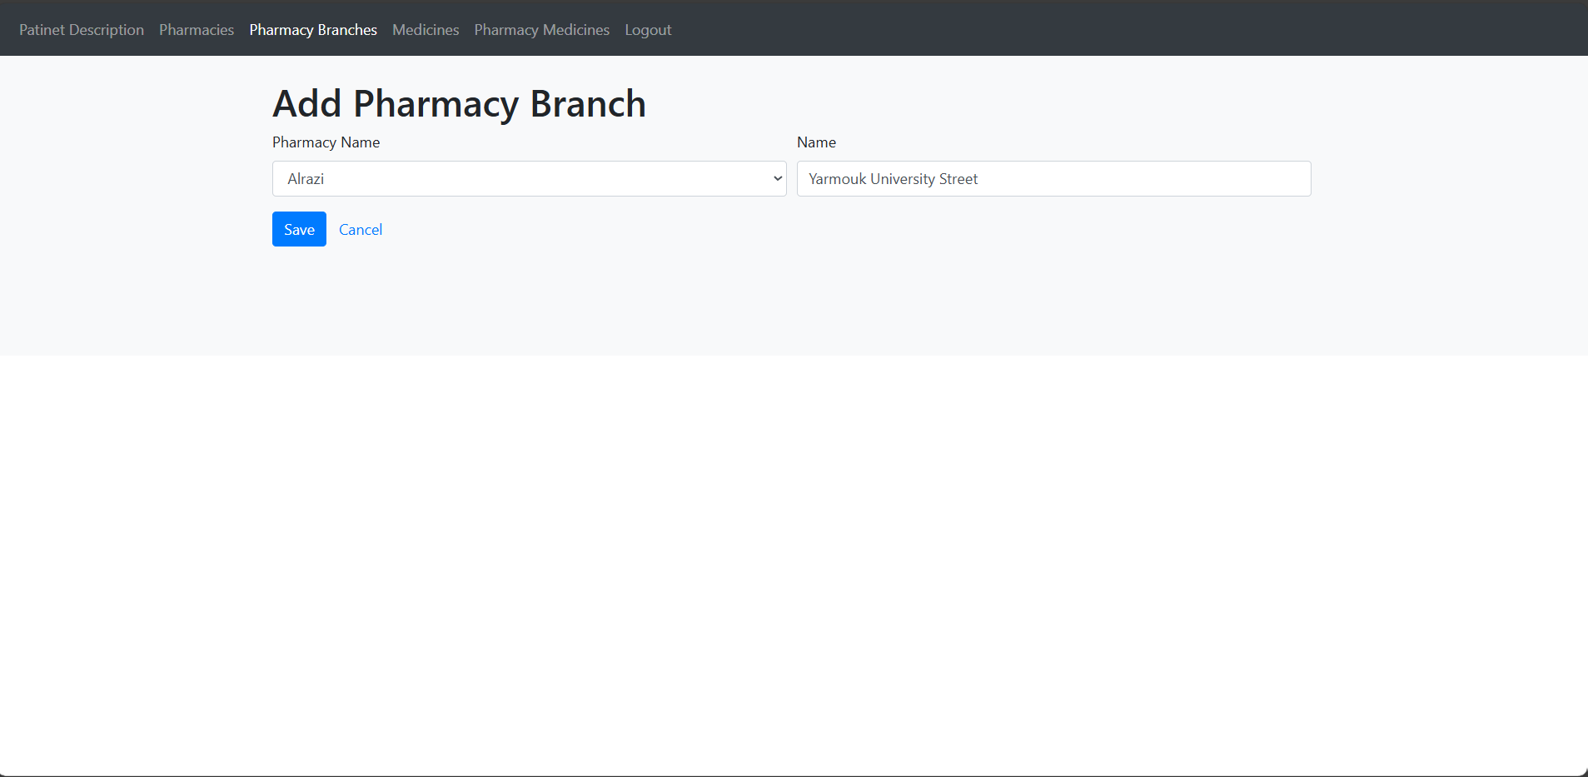
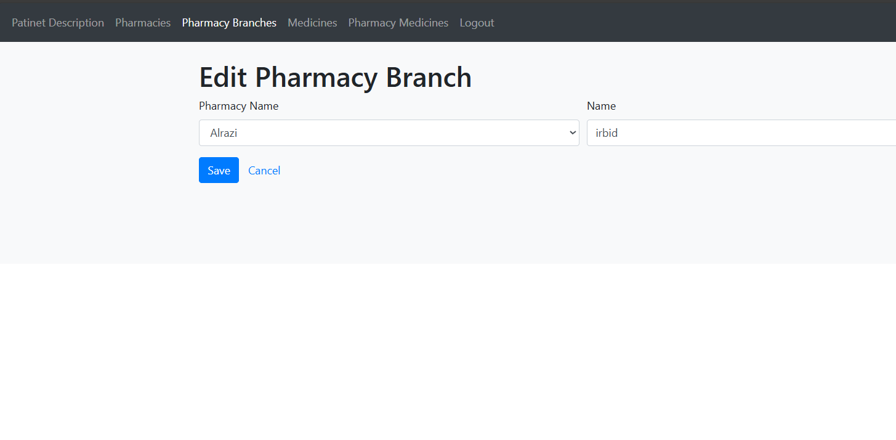
Implementation

Slide 27
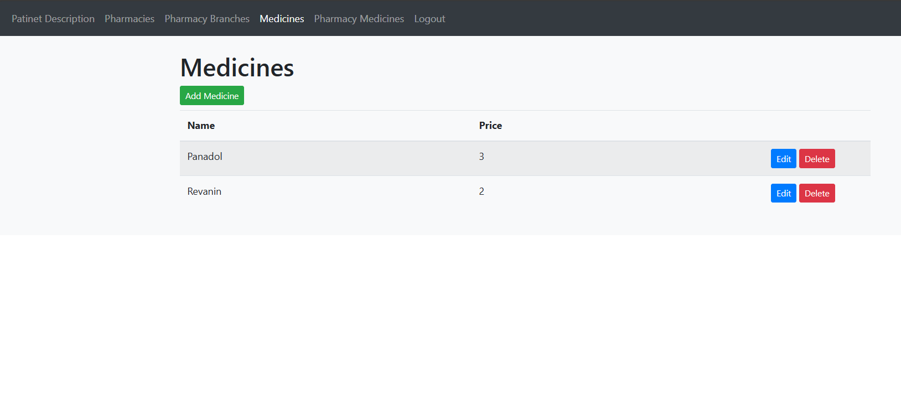

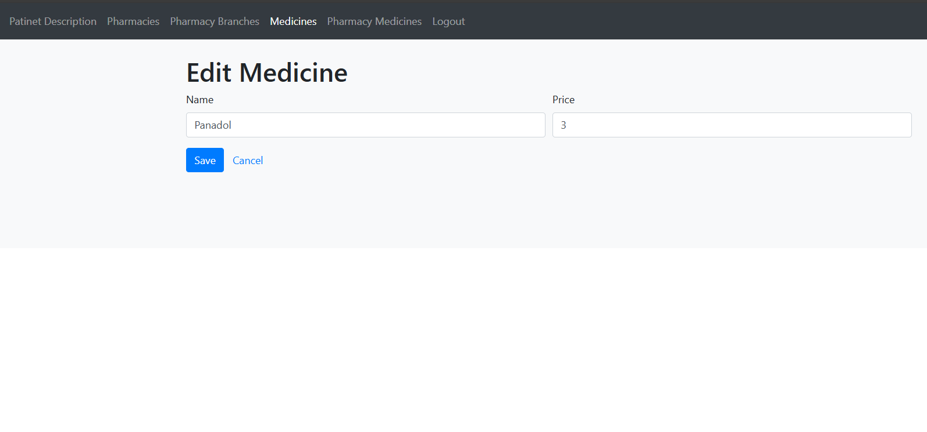
Implementation

Slide 28

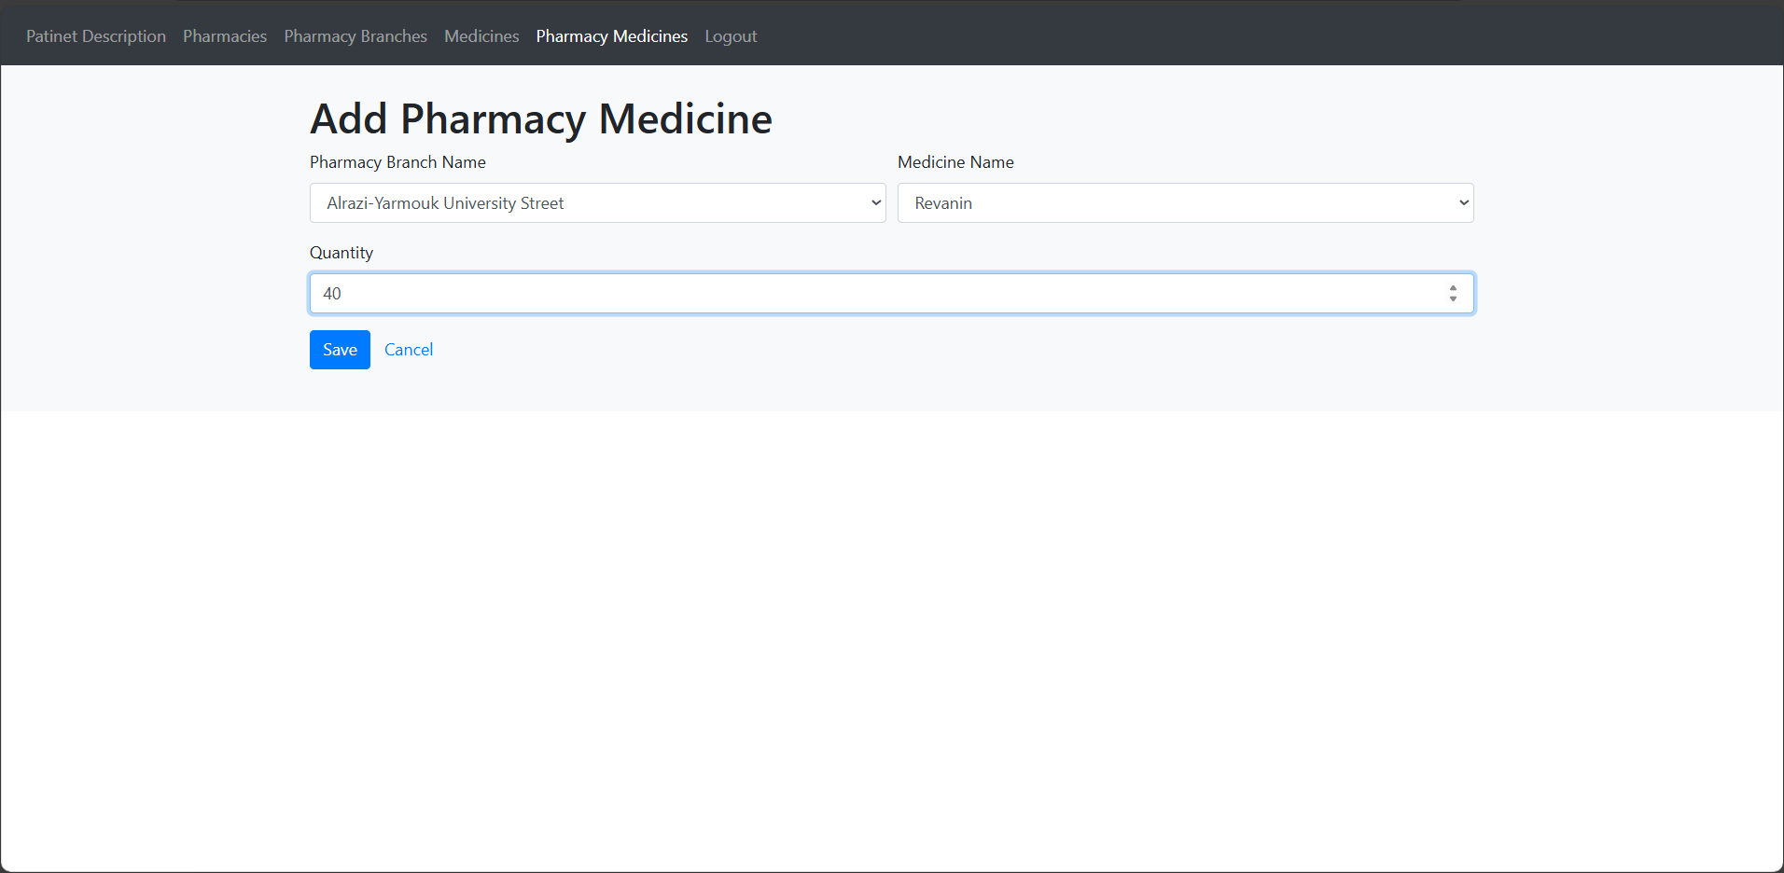
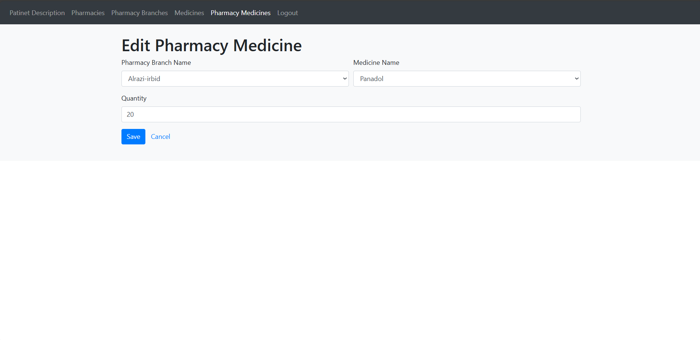
Implementation

Slide 29
Implementation
Services
For Patient ( as show in the figures, slide (30)) :
Login , Logout.
View Patient description.

Slide 30
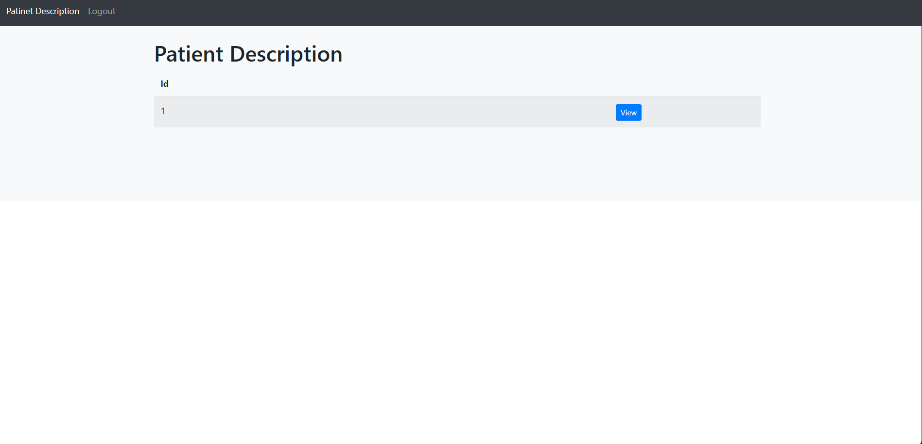
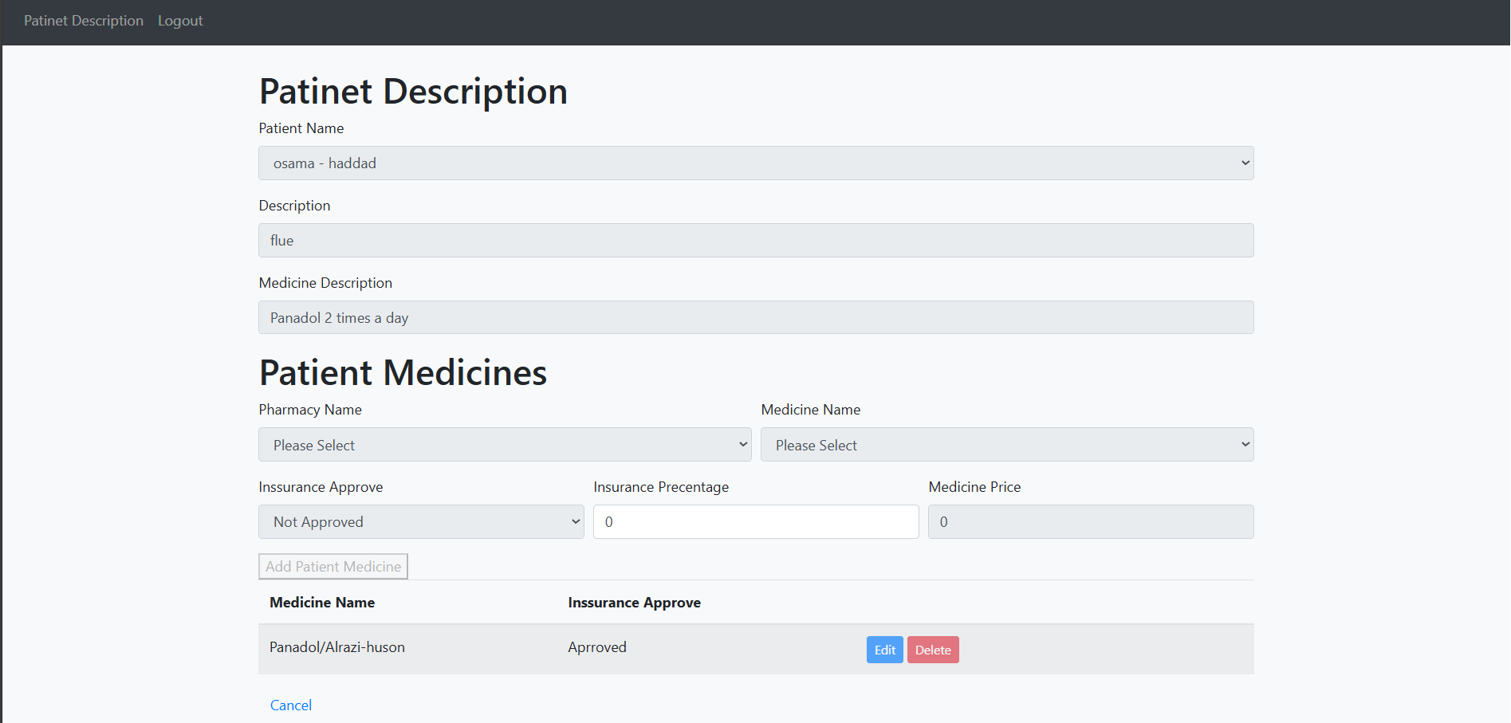
Implementation

Slide 31
04 Future Works

Slide 32
Future Works
Mobile Application Development:
Create a mobile app to supplement the web-based system, enabling medical professionals to view and control prescriptions while on the go. Flexibility and accessibility would rise as a result.
Artificial Intelligence and Machine Learning:
Use AI and machine learning algorithms to offer early detection of probable drug interactions or contraindications, individualized medicine recommendations, and predictive analytics.

Slide 33
05 Conclusion

Slide 34

Conclusion
The electronic prescribing web app improves medication prescribing by enhancing accuracy, efficiency, and patient safety. It reduces errors, simplifies workflows, and supports healthcare providers in delivering quality care. This project highlights the crucial role of digital tools in modernizing healthcare and optimizing services.

